Slide 1
t-distribution

Slide 2
If the standard deviation is unknown…
We need to estimate the value of the standard deviation using the sample data ! !
The probability that our statistic is reasonable is higher ? or lower ?

Slide 3
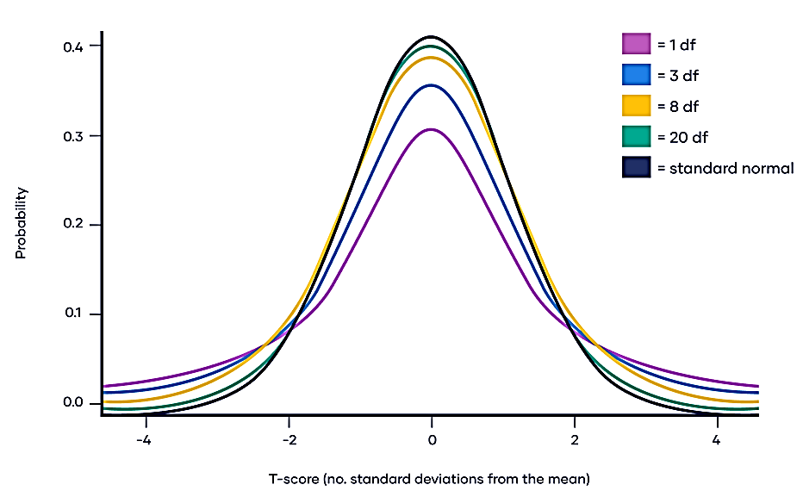

Slide 4
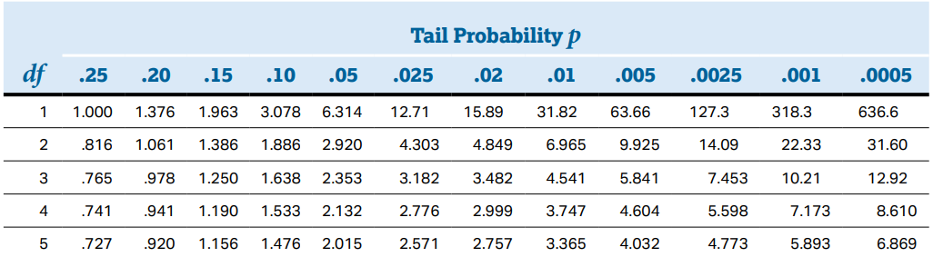
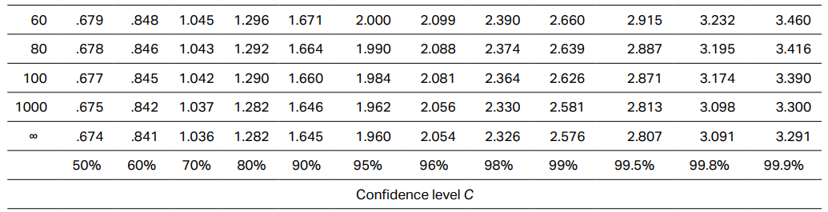
… …

Slide 5
https://www.youtube.com/watch?v=GFzCIA9kppM

